Slide 1

Simulation of IoT Based Smart Home Design Using MQTT Protocol
A project submitted in partial fulfilment of the requirements for the degree of
B.Sc. (Engg.) in Computer Science and Engineering.
By
Muhammad Ainal Haque
Registration No: 2015-12-09
Session: 2015-16
Under the guidance of
Ahmed Imtiaz
Lecturer
Department of Computer Science and Engineering
Rangamati Science and Technology University
Rangamati-4500, Bangladesh
March, 2022

Slide 2
Outlines
Objectives
What is MQTT & Smart Home (Working Process)
Related Works
Methodology
Result and Discussion
Conclusion & Future Work
References

Slide 3
Objectives
To design and Simulation of IoT based Smart Home design
Subnetting the whole network device process
To provide a realistic simulation and visualization of IoT smart devices
To control the Home devices with Controllers
such as PC or a dedicated Home Controller

Slide 4
What is MQTT Protocol and How It Works?
MQTT is a lightweight subscribe informing protocol designed for M2M
telemetry in remote wide environments.

Slide 5



What is MQTT Protocol and MQTT-How It Works?
Send a Command to control and output.
MQTT
MQTT
Node A
Read and Publish the output.
MQTT
MQTT
Node A

Slide 6
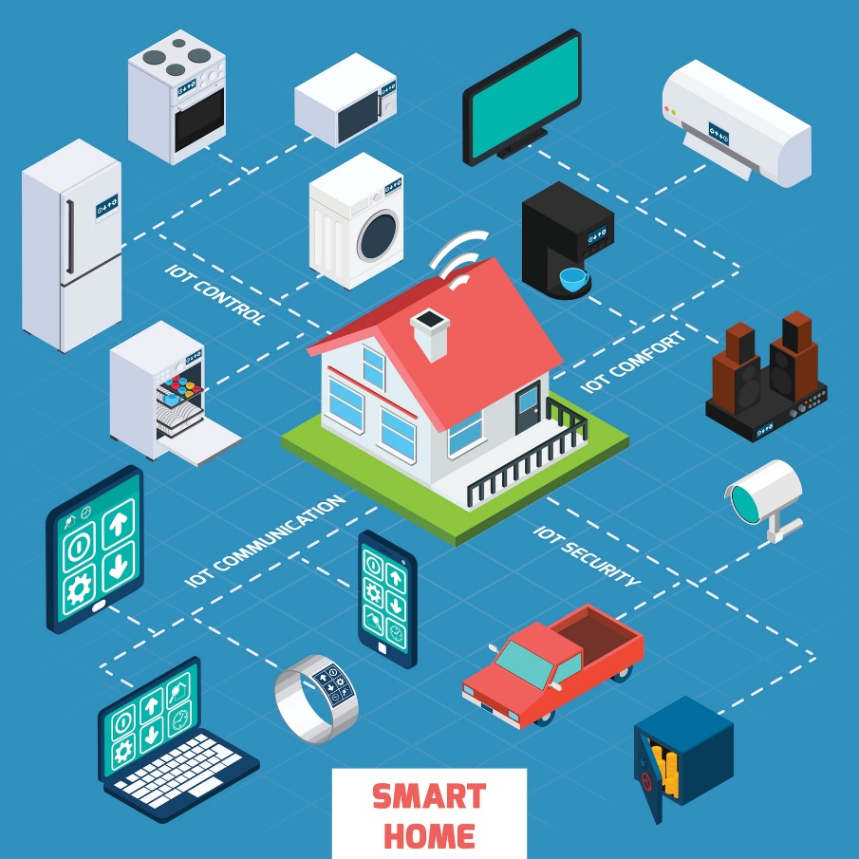
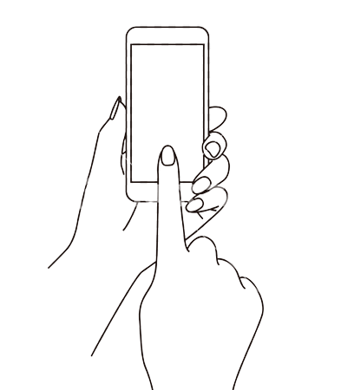
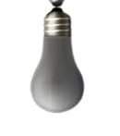
What is Smart Home and How It Works?
Smart Home is an home automation can also be accomplished with the help of a wireless controller.
Cloud
Home Gateway
MQTT
MQTT
Client
MQTT
Client
Smart Phone with App
Light

Slide 7
Related Works

Slide 8
Methodology (Haware And Software Requirements)
Sensors:
Temperature, Humidity, Daylight or Motion Detector.
PC or a dedicated Home automation controller
ISP, Router, DNS Server and IoT Server.
Graphical User Interface (GUI).
To Simulation we have to also need the Cisco Packet Tracer 7.2.2 Software and MQTT Protocol.

Slide 9
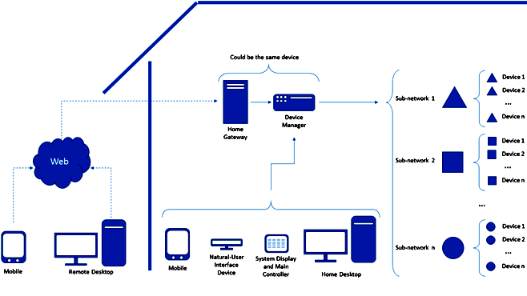
Methodology (Smart Home Block Diagram)

Slide 10

Methodology (The Device Addressing by Subnetting Process)
Device 1
Sub-Network - 1
Device 2
… … ….
Device n
Three Types IP Used for Subnetting of devices
Device 1
Sub-Network - 2
Device 2
… … ….
Device n
Device 1
Sub-Network - n
Device 2
… … ….
Device n
User
Mobile
Device Manager

Slide 11
Results Discussion In Smart Home
In Smart Home can't pass signal from clients (smart phone) to home devices.
Cloud
Home Gateway
MQTT
MQTT
Client
No Pass
MQTT
Client
Smart Phone with App
Light OFF

Slide 12

Results Discussion In Smart Home
In Smart Home pass the signal from clients (smart phone) to home devices.
Cloud
Home Gateway
MQTT
MQTT
Client
MQTT
Client
Smart Phone with App
Light ON

Slide 13
Results Discussion In Smart Home
Benefits of Smart Home Automation Design :
Results in convenience
Energy efficiency
Safety benefits
Manage devices from a central point
Save time and money
Remote control of the home when you are out of home and town

Slide 14
Results Discussion In Smart Home (Comparison between Our IoT System and Other IoT System)
Name | Our IoT Monitoring System | Other IoT Monitoring System
Working Condition | Best | Good
Monitoring Distance | From anywhere (Remotely) | Distances Limited
Wi-Fi | built-in (For Connection) | Arduino doesn’t have built-in Wi-Fi.
Alarming Signal | Best and Fast | Good and Medium
Subnet | Subnet ensure each devices | Subnet not sure each devices
Generation | 3G/4G | 2G/3G
Protocol | MQTT, OMA Lightweight M2M (LwM2M) | Undefined
Password | Strong and Secure [AES] | Week and Not Secure
Security | Best | Good
Efficiency | Best | Average

Slide 15
Conclusion & Future Work
The Simulation IoT Based Smart Home Design Using MQTT Protocol Smart Devices management system with sensors framework makes use of different developments in its design, development, and execution.
This will assist web application users within best security, which will help to meet the demand for monitoring the condition of the house quickly and safe

Slide 16
References
Erdal Ozdogan, R. D. (2021). IoT based a Smart Home Automation System Design: Simulation Case. n Balkan Journal of Electrical and Computer Engineering, 9, 5. doi: 10.17694/bajece.918826
Kurose, J. F., & Ross, K. W. (2013). COMPUTER NETWORKING A Top-Down Approach. (S. EDITION, Ed.) Pearson Education, Inc. Retrieved 2019, from https://eclass.teicrete.gr/modules/document/file.php/TP326/%CE%98%CE%B5%CF%89%CF%81%CE%AF%CE%B1%20(Lectures)/Computer_Networking_A_Top-Down_Approach.pdf
Roy, S., & Kumar, S. (2012). A Smart Home Automation by Using Internet of Things at CISCO PACKET TRACER 7.2.0. International Journal of Scientific Research in Computer Science Applications and Management Studies, 1. Retrieved 11 26, 2020, from http://www.ijsrcsams.com/images/stories/Past_Issue_Docs/ijsrcsamsv8i5p18.pdf
Kumar, P. P., Krishna, M., & Ramprakash, M. R. (2019). Design and implementation of smart home using Cisco Packet Tracer simulator 7.2. International Journal of Innovative Technology and Exploring Engineering, 8(11S), 107-111.
Ashok, G. L. P., Akram, P. S., Neelima, M. S., Nagasaikumar, J., & Vamshi, A. (2020). A. Implementation of Smart Home by Using Packet Tracer. International journal of scientific & technology research, 9(2), 678-685
… … …….
Tarkaa, N. S., Iannah, P. I., & Iber, I. T. (2017). Design and simulation of local area network using cisco packet tracer. The International Journal of Engineering and Science, 6(10), 63-77

Slide 17
Thanks To All!!!

